Slide 1
Today’s Agenda
Steps to design combinational circuit.
Half adder, full adder and four bit adder and subtractor circuit.

Slide 2
Design of Combinational Circuits:
From Specifications, determine the required number of inputs and outputs
Assign a variable to each input and output
Derive a truth Table that defines the required relationship between inputs and outputs
Perform logic minimization
Draw the logic diagram

Slide 3
Example:
Design a combinational circuit with three inputs x,y,z and three outputs A,B and
C. When the binary input is 0,1,2 or 3 the binary output is two greater than the
Input. When the binary input is 4,5,6 or 7 the binary output is three less than the
Input.

Slide 4
Example:
Design a digital circuit with the output f and inputs A,B,C and D. Let the two inputs AB represent a two bit number with A as the high order bit, and CD represent another two bit number. The values on AB and CD represent four values 00 (0), 01 (1), 10 (2), and 11 (3). The output ‘ f ’ should be 1 only if the number represented by AB is greater than or equal to the number represented by CD.

Slide 5
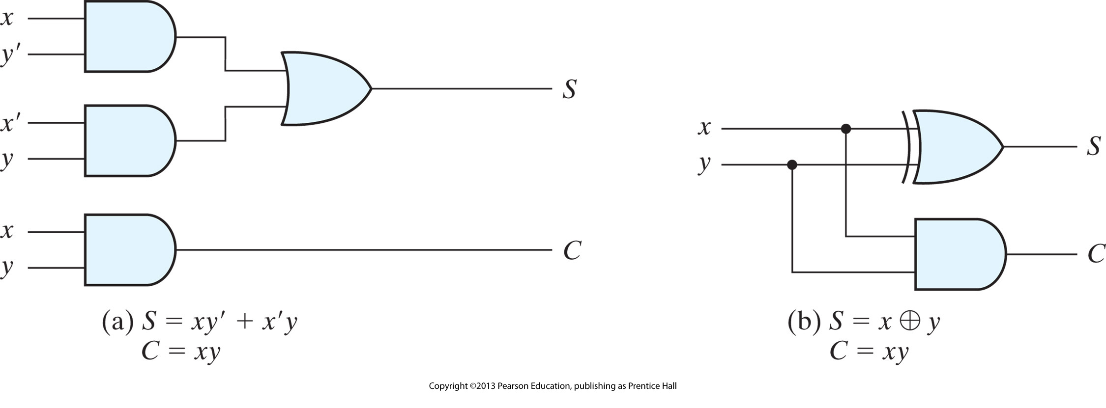
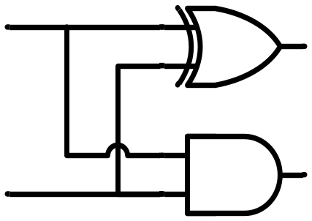
Half Adder (Design)
x
y
S
C
HA
x
+ y
───
C S
x y | C S
0 0 | 0 0
0 1 | 0 1
1 0 | 0 1
1 1 | 1 0
x
y
S
C
S represents LSB

Slide 6
Full Adder (Intro)
Background:
  Let us analyze if HA can fulfill our requirements
  Limitation of HA is that it can handle only 2 bits
  We need an adder which can add 3 bits (2 bits in question + 1 bit previous carry)
  Need for Full Adder
Example
1
1
1
1
1
1
1
1
1
1
0
1
+
1
0
1
1
1
1
0
1
0
1
0
0

Slide 7
Full Adder (Intro)
x
+ y
+ z
───
C S
x
y
z
S
C
FA
x y z | C S
0 0 0 | 0 0
0 0 1 | 0 1
0 1 0 | 0 1
0 1 1 | 1 0
1 0 0 | 0 1
1 0 1 | 1 0
1 1 0 | 1 0
1 1 1 | 1 1
 |  |  |  | y
 |  | 0 | 1 | 0 | 1
x |  | 1 | 0 | 1 | 0
 |  |  | z
S = xy'z'+x'yz'+x'y'z+xyz = x ⊕ y ⊕ z
 |  |  |  | y
 |  | 0 | 0 | 1 | 0
x |  | 0 | 1 | 1 | 1
 |  |  | z
C = xy + xz + yz

Slide 8
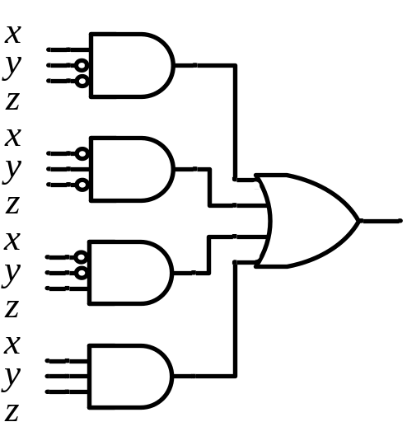
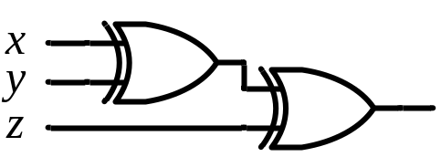
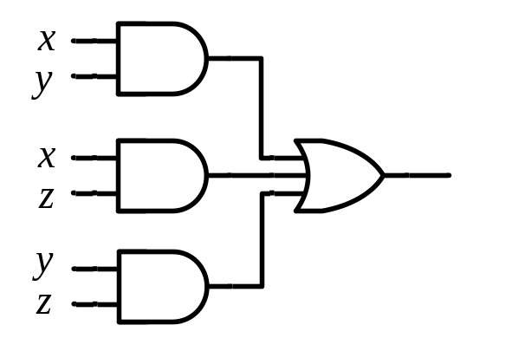
Full Adder (Design)
S = xy'z'+x'yz'+x'y'z+xyz = x ⊕ y ⊕ z
x
y
z
S
C
C = xy + xz + yz
FA
x
y
z
S
C
S
C
x
y
z

Slide 9

Full Adder using HAs (Design)
x
y
z
S
C
x
y
S_{p}
C₁
S_{p}
z
S
C₂
FA
HA 1
HA 2
x
+ y
+ z
───
C S
x
+ y
───
C₁ S_{p}
S_{p}
+ z
───
C₂ S
x y z | C S
0 0 0 | 0 0
0 0 1 | 0 1
0 1 0 | 0 1
0 1 1 | 1 0
1 0 0 | 0 1
1 0 1 | 1 0
1 1 0 | 1 0
1 1 1 | 1 1
S_{p}
HA 1
HA 2
x
y
z
C₁
C₂
S
C
C = 1 if C₁ = 1 OR C₂ = 1

Slide 10
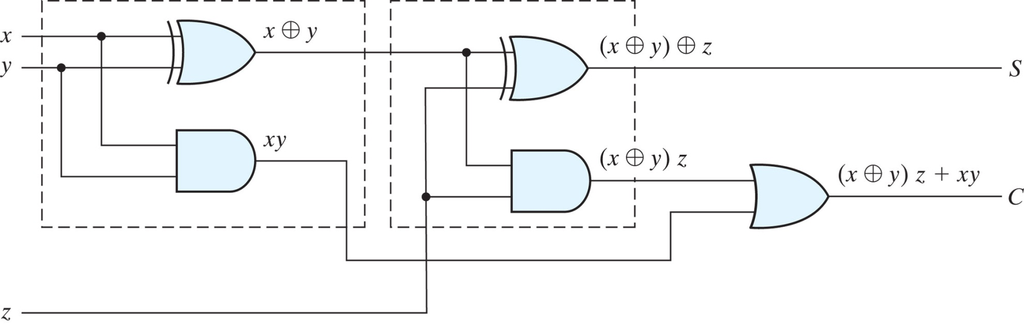
Full Adder (Design)
x
y
z
S
C
FA

Slide 11

Binary Adder
x₃x₂x₁x₀ y₃y₂y₁y₀
c₃ c₂ c₁ .
x₃ x₂ x₁ x₀
+ y₃ y₂ y₁ y₀
────────
C₄ S₃ S₂ S₁ S₀
1 HA & 3 FA
Binary Adder
C₄
C₀ =0
4 FA (C₀=0)
Carry Propagate Addition
S₃S₂S₁S₀
x₃ x₂ x₁ x₀
y₃ y₂ y₁ y₀
0
FA
FA
FA
FA
C₄ C₃ C₂ C₁
S₃ S₂ S₁ S₀

Slide 12
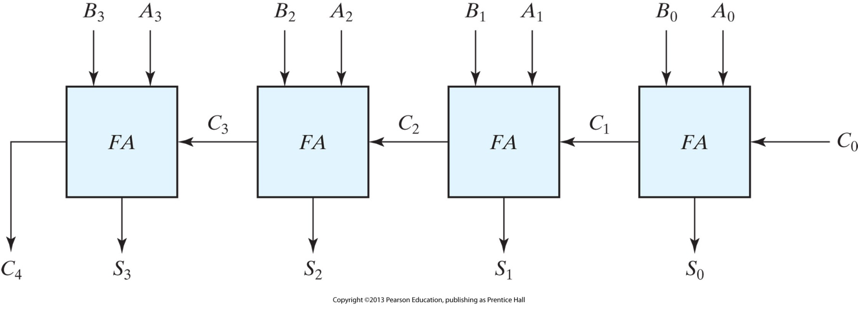
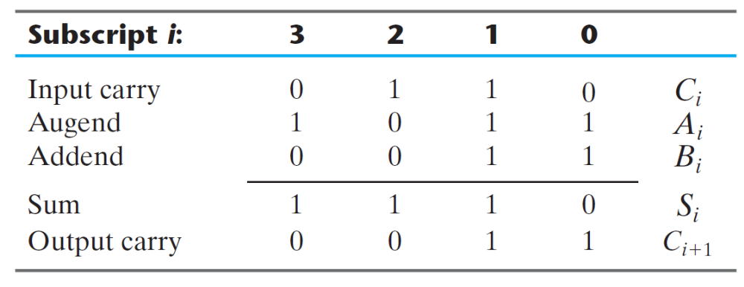
Binary Adder
C
A
R
R
Y
P
R
O
P
A
G
A
T
I
O
N
NOT available immediately
Available

Slide 13
Binary Adder (Observation)
x₃x₂x₁x₀ y₃y₂y₁y₀
Binary Adder
C₄
C₀ =0
S₃S₂S₁S₀
How many I/ps? = 9
The design of this cct. by classical method would require a truth table with 2⁹ = 512 entries
Using an iterative method of cascading a standard function, a simple implementation is possible

Slide 14
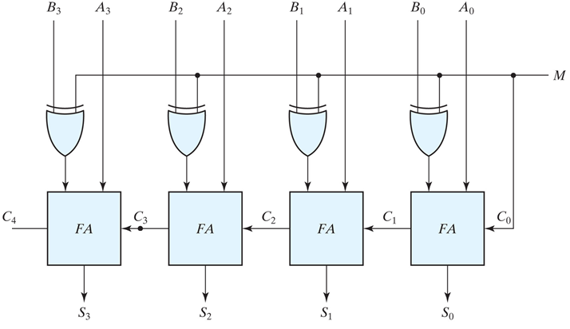
Binary Adder/Subtractor (Design)
Binary numbers in the signed-complement system are added and subtracted by the same rules as are unsigned numbers
Same H/ware. Programmer specifies (signed/unsigned) in software

Slide 15
Binary Adder/Subtractor with Overflow Detection
Overflow
  Occurs when two numbers with n bits each are added and the sum is of n+1 digits
  Happens for decimal/binary numbers unsigned/signed
  Detection of overflow for unsigned/signed is different
Overflow Detection (Unsigned numbers)
  Overflow will occur after addition.
  Carry simply indicates overflow
x₃ x₂ x₁ x₀
y₃ y₂ y₁ y₀
0
FA
FA
FA
FA
Carry
C₄ C₃ C₂ C₁
S₃ S₂ S₁ S₀

Slide 16
Detection of Overflow in Case of 2’s Complement Representation.
  Using 2’s complement representation both positive and negative numbers can be represented.
  Overflow will occur after addition if both numbers are positive or negative.
  No overflow will occur after subtraction if both numbers are either positive or negative.
  No Overflow will occur after addition if one number is positive and other is negative.

Slide 17
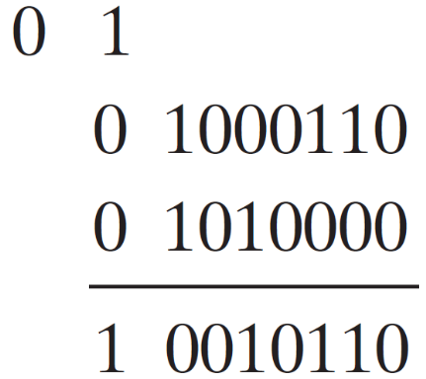
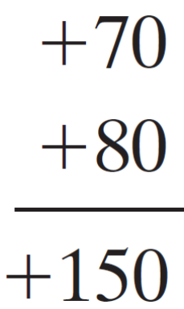
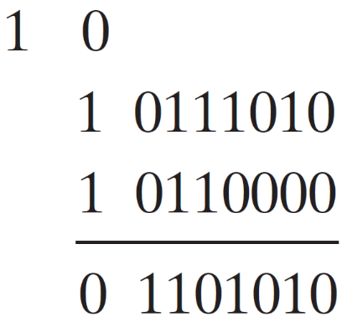
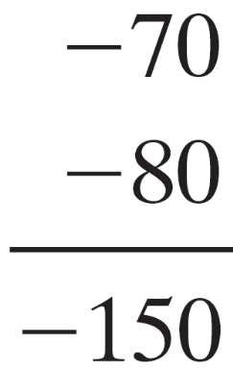
Binary Adder/Subtractor with Overflow Detection
Overflow Detection (Signed numbers)
  Consider two (8-bits) signed no. 70 and 80
Example
Correct in 9 bits (MSB =0)
-ive !!!
Correct in 9 bits (MSB =1)
+ive !!!

Slide 18

Binary Adder/Subtractor with Overflow Detection
Overflow Detection (Signed numbers)
  Cases of Overflow: How we can detect it?
Example
If the carries in the last two stages are different, an overflow occurs

Slide 19
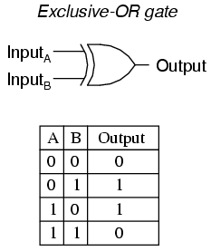

Binary Adder/Subtractor with Overflow Detection
If the carries in the last two stages are different, an overflow occurs
x₃ x₂ x₁ x₀
y₃ y₂ y₁ y₀
0
FA
FA
FA
FA
Overflow
C₄ C₃ C₂ C₁
S₃ S₂ S₁ S₀

Slide 20
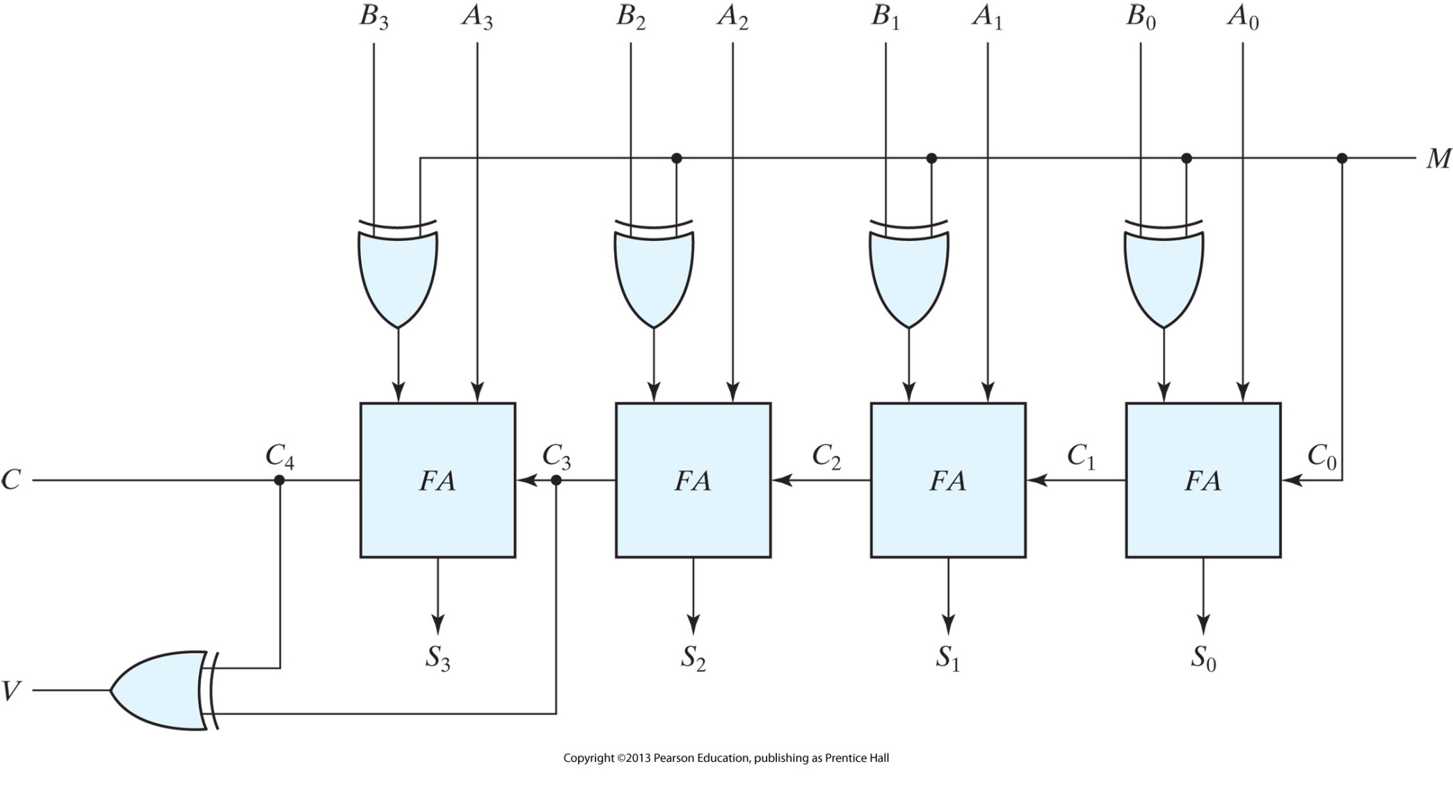
Binary Adder/Subtractor with Overflow Detection

Slide 21
Practice Problems for Quiz 3
3.13, 3.15, 3.16, 3.17, 3.20, 3.21
4.1, 4.2, 4.3

